Slide 1
Capstone Project-1
Play Store App Review Analysis
BY:
Rushabh Tikale

Slide 2
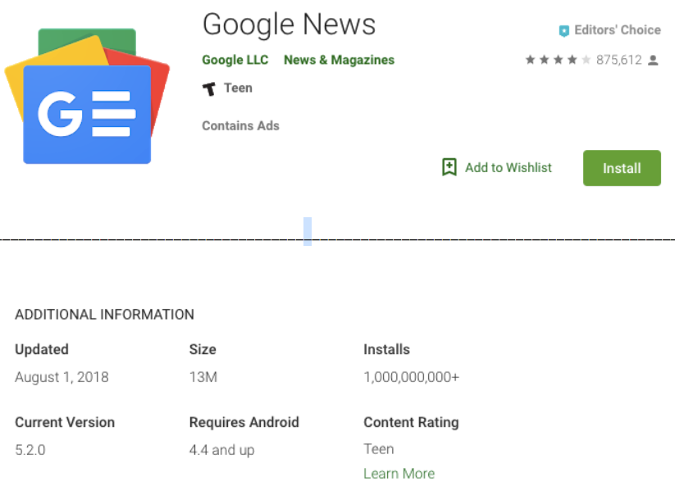
Let’s Deep Into Play Store:
Checking null values
in data.
2.Checking duplicates.
3.Clean data.
4.EDA on data.
5.Conclusion.

Slide 3

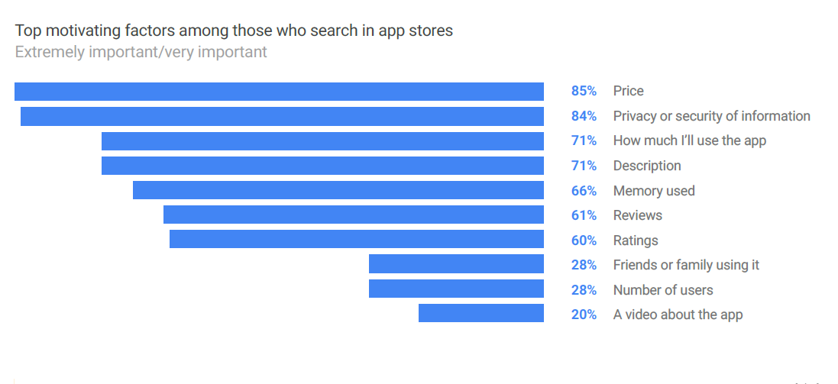
The Motive :
Important Factors while Installing Of Apps:
Play store had widely network its get trouble for users to install the apps from play store. Following are the major roles for user while installing any apps from play store.

Slide 4

Fetching Data:
Data Processing-1: In this first part we check the present null values in data and trying to remove it.
DATA PROCESSING-2: In this second part we check the duplicates and remove it.
ClEAN DATA: In this part we clean data which is very important for further visualization.
EDA: In this part we do the visualization on our clean data.
Conclusion: This is last but not the least we make a conclusion on our whole process.

Slide 5
Data Summary:
Category: The category decides the belonging of different apps from different category. This useful for categorized the apps for spreading the data in one form.
Rating: The rating is usually decides the rating of different apps .It makes more impact while installing apps .Rating made through the performance of app if the performance is good the rating will good.

Slide 6
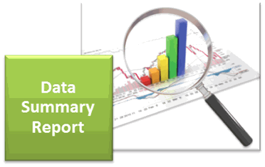
Data Summary:
Reviews: Reviews are also as similar to rating it also made similar impact as rating. In short we can say that this are pretty important for deciding the quality of apps .
Size : The size of apps decides the required space in your storage. Mostly user prefer low size of apps for convenient to use and required low data to installs.
Price : The price is different for all paid apps . The price of apps affect the installing for users .

Slide 7
Data Summary:
Installs : It is numerical data denoting the number of installs of apps. It is useful for the owner of apps it decides how the app is running in global network.
Type : The app are of usually two category :
Paid: The charges of app allocated for the apps in play store . The user always try to use free apps so this will make impact on the installing as the cost of apps increases installing rate will decreases
Free : It Is totally free for all users in worldwide
area. User mostly afford it.

Slide 8

What Is Data Cleaning ?
Data cleaning is the most and most important part in EDA. As we get in the name the total meaning is getting out of from there. But the actual part is raw data which is present on any of data .
So most important to remove unnecessary data . If any raw data is present it will affect our visualization. Now we can say cleaning is most useful to built the future model.

Slide 9

Moving To EDA:
EDA(Exploratory Data Analysis) is the major source to get to know what actually data want to say . In data science the data is having large number of column and rows unable to read for users
So EDA helps us to learn data which is more complicated and try to make more readable as compared normal data , it is widely used in data science and in ML also .

Slide 10
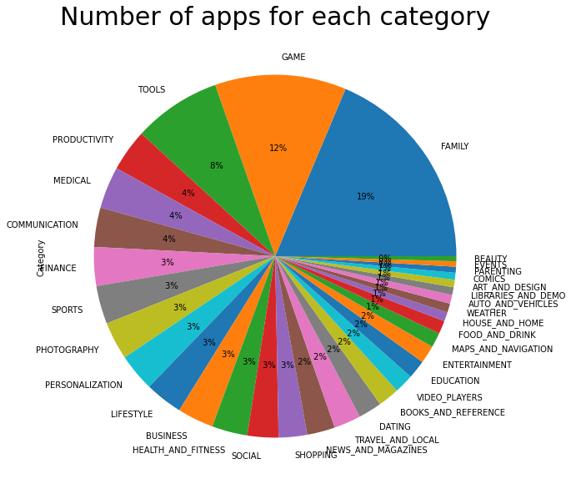
Apps For Each Category:

Slide 11
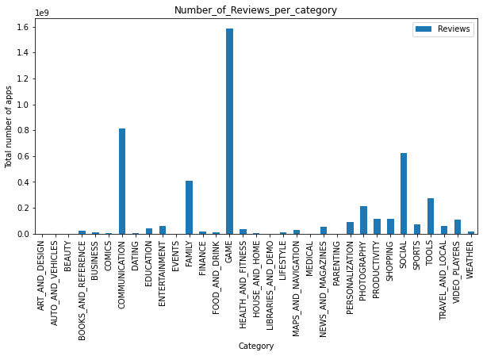
Reviews Per Category

Slide 12
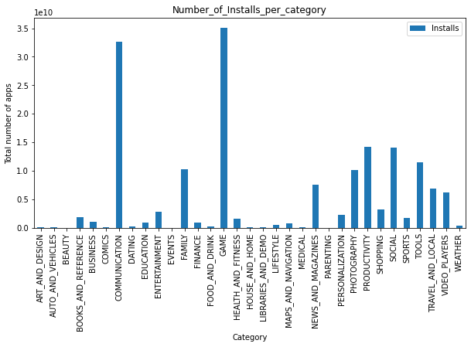
Installs Per Category:

Slide 13
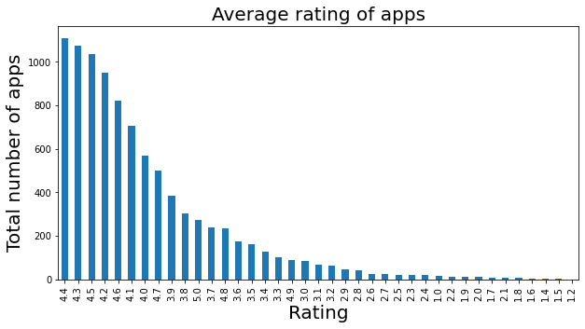
Average Rating Of Apps:

Slide 14
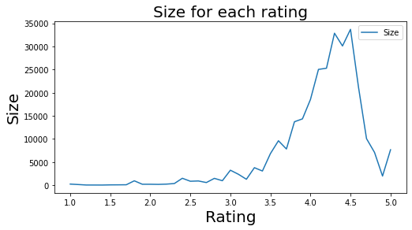
Size For Each Rating:

Slide 15
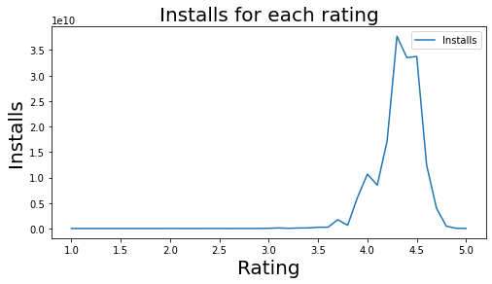
Installs For Each Rating:

Slide 16
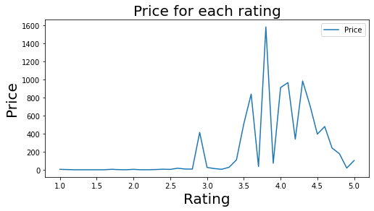
Price For Each Rating:

Slide 17
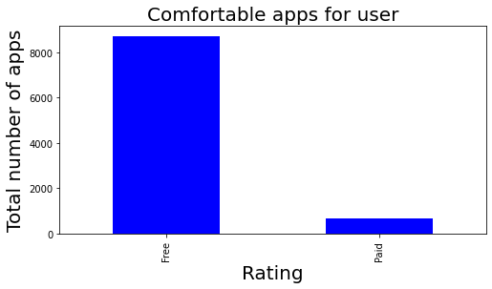
Preferred Apps For Users :

Slide 18
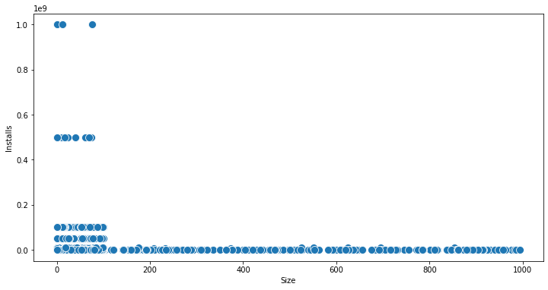
Impact Of Size On Installs

Slide 19
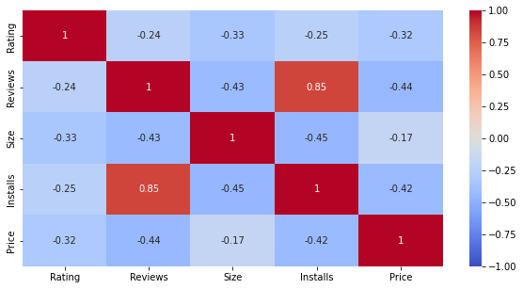
EDA On Relation :

Slide 20

Working On Reviews Of Data :
Why review is important ?
The most obvious reason, why your app’s rating in mobile stores matter is that a great rating and a bunch of positive reviews impresses potential users. And to be honest, who doesn’t want to be honored for great work? In fact, app store reviews and ratings can give your app an competitive edge.
Let’s take a look at this example. There are tons apps ranking for the search term “QR Code Scanner”. Thus, you should not only optimize your keyword strategy, but achieve a good rating through a presentable number of user feedbacks.

Slide 21
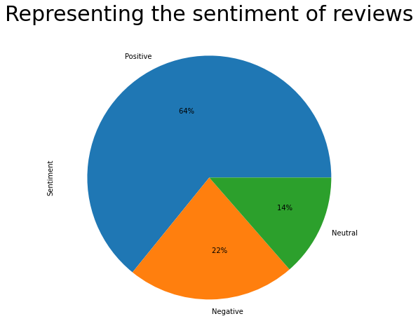
Sentiment Of Reviews:

Slide 22
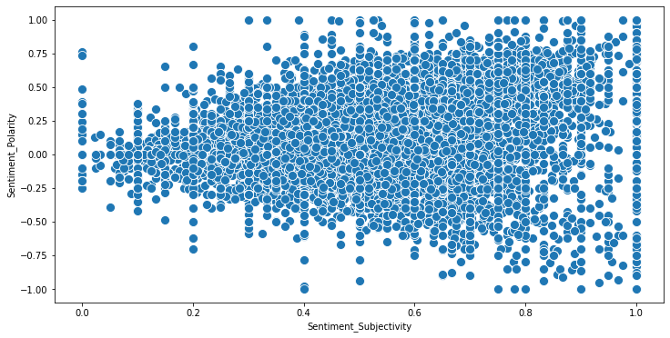
Relation On Sentiment Of Reviews:

Slide 23
Conclusion
That's it! We reached the end of our exercise.
We worked with different aspects ,our first approach was on which point we have to explained this was our major outcomes.
Then we move with motive of our data in which we learn what factors is essential to download the apps from play store , we get clear inclusion from there.
The next part of our project is we done fetching of data which gives us a idea of what type of data in which we have to work on it.
Data Summary is the next part of our project ,we basically summarize the numerical features which helps to work on EDA.

Slide 24

Conclusion (Continued)
We must to know what is data cleaning? so we just giving edge to our concept that every one should know data cleaning .
Then we move with EDA which was contained of different type of analysis ,we look individually on category for apps .
Now the last but not least we come with the reviews features of our dataset which helps us to learn the development of our apps.
considering reviews of customer Sentiment are of positive ,negative and neutral of customer.

Slide 25

Challenges
The data has a lot of chunk features everyone not be missing so handle with care to our dataset.
The data must be clean, a single string can make our total data irrelevant for analysis.
User reviews and play store are of two types data which have to work simultaneously is considering a bit time consuming .

Slide 26
Q & A

